Slide 1


Slide 2
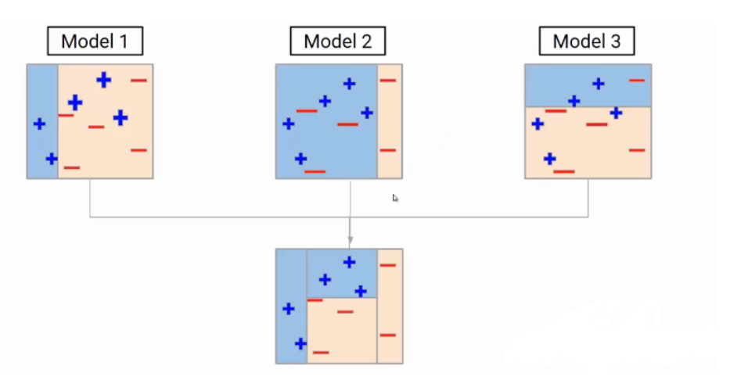
Ada Boost (or) Adaptive Boosting
Weak Learner1
Weak Learner2
Weak Learner3
Stronger Model
AdaBoost (Adaptive Boosting) is an ensemble learning method that combines multiple weak learners to create a stronger model.
AdaBoost algorithm works by training weak learners in a sequence and focusing on correcting mistakes made in earlier steps

Slide 3
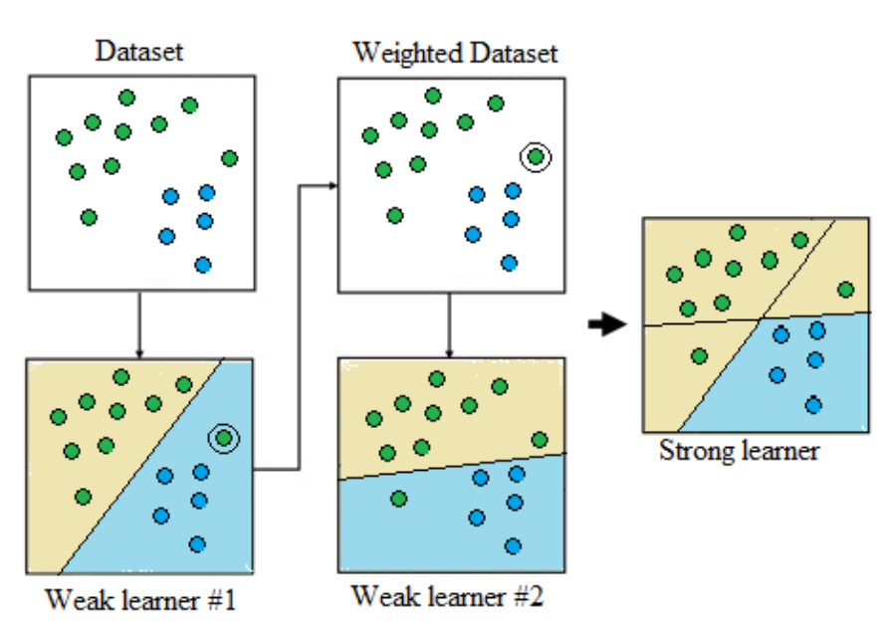
How Does AdaBoost Work?
The AdaBoost algorithm works by training weak learners in a sequence and focusing on correcting mistakes made in earlier steps.
simple breakdown of the process:
Initialize Weights for all Data Points
Train the Weak Learner
Calculate Error
Adjust Weights
Repeat
Final
Model

Slide 4
AdaBoost Algorithm Parameters
Number of Weak Learners
Base Estimator
Learning Rate
Loss Function

Slide 5
Advantages of AdaBoost
Improved Accuracy
Adaptability
Ease of Implementation
Handles Imbalanced Datasets

Slide 6
Disadvantages of AdaBoost
Sensitive to Noisy Data
Computationally Intensive
Overfitting
Limited Flexibility with Weak Learners

